Slide 1
Online Payment Fraud Detection using Machine Learning in Python
Submitted in the partial fulfillment for the award of the degree of
BACHELOR OF ENGINEERING
IN
CSE-AIML
Submitted by:
Aditya Kumar-21BCS10345
Ankit Kumar-21BCS10065
Utkarsh Pathak -21BCS6158
Under the Supervision of:
Ramanjot Kaur
Department of AIT-CSE
DISCOVER . LEARN . EMPOWER

Slide 2
Outline
Introduction to Project
Problem Formulation
Objectives of the work
Methodology used
Results and Outputs
Conclusion
Future Scope
References

Slide 3

Introduction to Project
With the exponential growth of e-commerce and online payment platforms, the security of digital transactions has become a paramount concern. This project aims to address the problem of online payment fraud detection by leveraging machine learning techniques to analyze transaction data and identify fraudulent activities.
By using a data-driven approach, the proposed system can uncover hidden patterns and anomalies that traditional rule-based systems often miss. The machine learning model will be trained on historical transaction data, enabling it to classify transactions as legitimate or fraudulent with a high degree of accuracy.

Slide 4
Importance of Fraud Detection Systems
Real-Time Transaction Monitoring : Fraud detection systems utilize sophisticated algorithms to monitor transactions in real-time, enabling immediate identification and response to suspicious activities, thereby preventing potential financial losses.
Enhanced Risk Management : By analyzing transaction data and consumer behavior, these systems provide insights that help businesses assess risks, allowing for the implementation of targeted strategies to mitigate fraud exposure.
Regulatory Compliance Assurance : Implementing robust fraud detection systems aids businesses in meeting regulatory requirements, ensuring the protection of consumer data and maintaining trust in financial transactions within the digital marketplace.

Slide 5
Impact of online Fraud on Business
Significant Financial Burden
Erosion of Customer Trust
Increased Compliance Requirements
Businesses face escalating costs from fraud, including direct losses, investigation expenses, and potential fines, which can severely impact profitability and operational budgets.
Repeated fraud incidents can lead to diminished consumer confidence, resulting in reduced customer retention and a shift towards competitors perceived as more secure.
Organizations must navigate complex legal frameworks and implement stringent security measures to avoid penalties, necessitating ongoing investment in compliance and risk management strategies.

Slide 6
Problem Formulation
Problem Definition
Project Overview
The rapid growth of online payment systems has created significant opportunities for fraudsters to exploit vulnerabilities in digital transactions, leading to unauthorized access, identity theft, and account takeovers. These fraudulent activities result in substantial financial losses and erode consumer trust.
This project seeks to develop a robust and scalable machine learning-powered fraud detection system to mitigate these risks. The proposed system will analyze vast amounts of transactional data to identify patterns and anomalies indicative of fraudulent behavior.

Slide 7

Objectives of the work
Build a robust fraud detection model using ML.
Improve the accuracy and recall of fraud prediction.
Reduce the number of false alarms.
Create a scalable system adaptable to different platforms.

Slide 8
Existing vs Proposed System
Traditional Rule-Based Systems
Machine Learning Approach
The proposed system uses machine learning algorithms to intelligently detect fraudulent transactions. By analyzing historical transaction data, the model learns complex patterns and relationships that may not be evident through manual analysis. Techniques such as Random Forest, Logistic Regression, and XGBoost are applied for classification.
Traditional fraud detection systems rely heavily on rule-based methods where fixed thresholds and manually crafted rules are used to flag suspicious transactions. Although simple to implement, these systems struggle to adapt to new, sophisticated fraud techniques and often result in high false positive rates.

Slide 9




Key Challenges in Fraud Detection
Imbalanced Dataset
Fraudulent transactions are rare compared to legitimate ones, leading to class imbalance, which affects model learning and prediction accuracy.
Feature Selection
Identifying the most relevant features to distinguish between fraudulent and legitimate transactions is challenging and critical for model efficiency and effectiveness.
Real-Time Analysis
The system must handle large transaction volumes in real time without delays to ensure uninterrupted user experience and quick fraud detection.
Model Accuracy
Achieving a balance between detecting fraud (high recall) and avoiding false alarms (high precision) is crucial, requiring careful optimization of model metrics like F1-score.

Slide 10
Methodologies
Data Collection
Gather transaction data from public datasets, synthetic data generation, or financial institution partnerships. Key attributes include transaction amount, timestamp, payment method, location, device type, and user behavior.
Data Cleaning
Remove duplicates, handle missing values using imputation techniques, and filter outliers using statistical methods like Z-score or IQR-based filtering to improve model robustness.
Addressing Class Imbalance
Apply techniques such as SMOTE (Synthetic Minority Over-sampling Technique), undersampling of legitimate transactions, or cost-sensitive learning to balance the dataset.
Feature Engineering
Extract important transaction attributes, select relevant features using statistical techniques, and apply dimensionality reduction methods like PCA to improve computational efficiency.

Slide 11
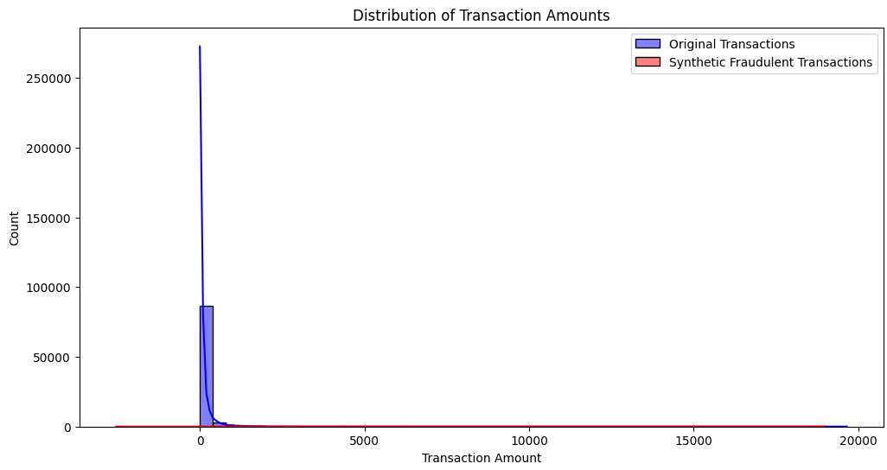
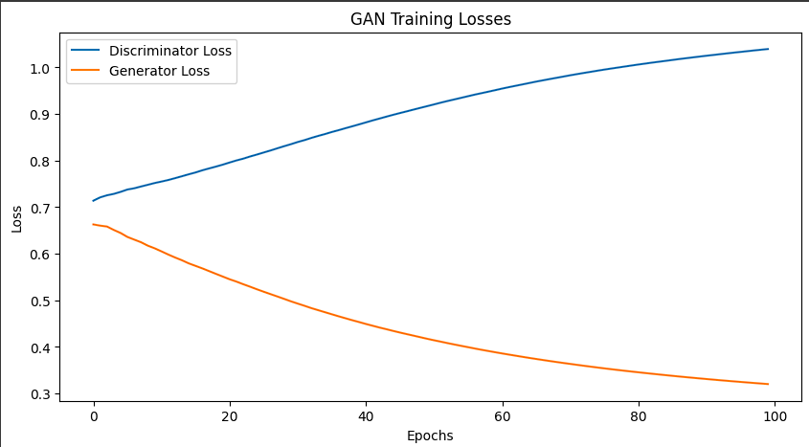
Results and Outputs
Best model: Random Forest
Accuracy: 79.18%
Precision: 89.87%
Recall: 33.65%
F1-Score: 48.91%
Fig: Data distribution
Fig: Plot Loss

Slide 12


Conclusion And Future Scope
Enhanced Security
Continuous Improvement
The machine learning-based approach provides a faster, more accurate, and adaptive fraud detection system compared to traditional rule-based methods, enhancing online transaction security while minimizing disruptions for genuine users.
Despite improvements in fraud detection systems, challenges like data asymmetry, adverse attacks, and the requirement for explainable AI models persist. Ongoing research and advancements in fraud detection frameworks are necessary to address these issues.

Slide 13
References
Kumar et al. (2023) - Ensemble-Based Approach for Fraud Detection.
Li & Chen (2022) - Autoencoder-based Anomaly Detection in Credit Card Transactions
Zhang et al. (2023) - LSTM-based Fraud Detection Model
Smith & Jones (2021) - Graph Neural Networks for Financial Fraud Detection
Patel et al. (2023) - Hybrid Model using Deep Learning and Reinforcement Learning
Lee et al. (2022) - Feature Selection Mechanism with PCA
Wong et al. (2022) - Synthetic Data Generation for Addressing Data Imbalance
Huang et al. (2023) - Adversarial Training to Enhance Model Robustness

